Slide 1


Crop and Fertilizer Recommendation System
BY:
Dharunkrishna P

Slide 2

Learning Objectives
Understand the Basics of Machine Learning:
Learn how to apply machine learning algorithms to solve real-world agricultural problems.
Understand the concepts of classification and model evaluation.
Data Preprocessing and Analysis:
Learn how to preprocess data, handle missing values, and extract features.
Analyze soil and crop data for meaningful insights.
Model Building and Training:
Develop a machine learning model (Random Forest Classifier) for crop prediction.
Learn how to train, test, and evaluate model performance.
Fertilizer Recommendation Logic:
Understand how to link crop predictions with suitable fertilizers for better yield.
Implement a recommendation system based on soil type and predicted crop.
GOAL
Source :
www.freepik.com/

Slide 3
Tools and Technology used
Programming Language: Python
Data Analysis: Pandas, NumPy
Machine Learning: Scikit-Learn (RandomForestClassifier)
Model Saving and Loading: Pickle
Integrated Development Environment (IDE): Jupyter Notebook, VS Code
Deployment (if extended): Flask or Django for web-based deployment
Version Control: Git, GitHub
File Handling: CSV for data storage

Slide 4
Methodology
Data Collection: Gather soil properties, crop types, and fertilizer information.
Data Preprocessing: Clean the data and select important features.
Model Training: Train a machine learning model (Random Forest) to predict suitable crops.
Fertilizer Mapping: Link each crop to its recommended fertilizer.
Recommendation System: Based on soil type, suggest crops and the best fertilizers.

Slide 5
Problem Statement:
Farmers often struggle to identify the best crops and suitable fertilizers for their soil type, leading to poor yield and inefficient use of resources. This project aims to develop a Crop and Fertilizer Recommendation System that helps farmers make data-driven decisions.
By analyzing soil properties like Nitrogen (N), Phosphorus (P), Potassium (K), temperature, humidity, pH, and rainfall, the system recommends the most suitable crops to plant. Additionally, it suggests the best fertilizers for optimal growth, ensuring better productivity and sustainable farming.

Slide 6
Solution:
Github Link: https://github.com/dharunkrishnap/Crop_and_Fertilizer/blob/310384da6ddb6e5507894de7a8c6b03e59148c15/Crop_Fertilizer_Recommendation_System.ipynb
To solve the problem of identifying the best crops and fertilizers for different soil types,The solution is structured as follows:
Data Collection:
Soil properties (N, P, K, temperature, humidity, pH, and rainfall) are collected along with the soil type.
Crop and fertilizer information is mapped for recommendation.
Data Preprocessing:
The collected data is cleaned and prepared for training.
Relevant features are selected, and data is split into training and testing sets.
Model Training:
A Random Forest Classifier is used to predict the best crop based on soil properties.
The model is trained on historical data to understand the relationships.
Fertilizer Mapping:
For each recommended crop, the most suitable fertilizer is fetched from a pre-defined mapping.
This ensures that the nutrients are optimized for soil health and plant growth.
Real-Time Recommendation:
The system allows users to input their soil type.
It then provides a list of the best crops to plant and the fertilizers to use.

Slide 7
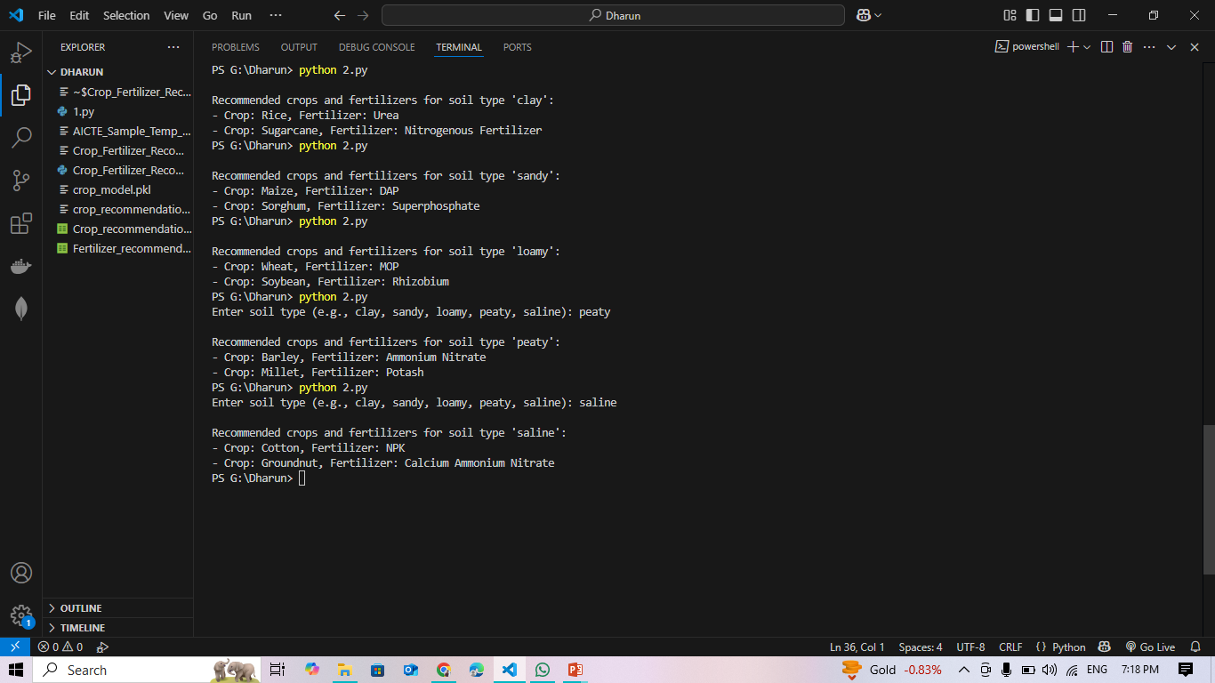
Screenshot of Output:

Slide 8
Conclusion:
The Crop and Fertilizer Recommendation System effectively bridges the gap between soil analysis and informed agricultural practices. By leveraging Machine Learning, the system accurately predicts the most suitable crops based on soil properties and recommends the right fertilizers to enhance productivity.
This solution empowers farmers to make data-driven decisions, leading to:
Improved crop yield
Optimal use of soil nutrients
Reduced wastage of fertilizers
Sustainable and environmentally friendly farming
Overall, the system not only boosts agricultural efficiency but also supports sustainable farming, ensuring long-term soil health and better economic outcomes for farmers.

